Slide 1
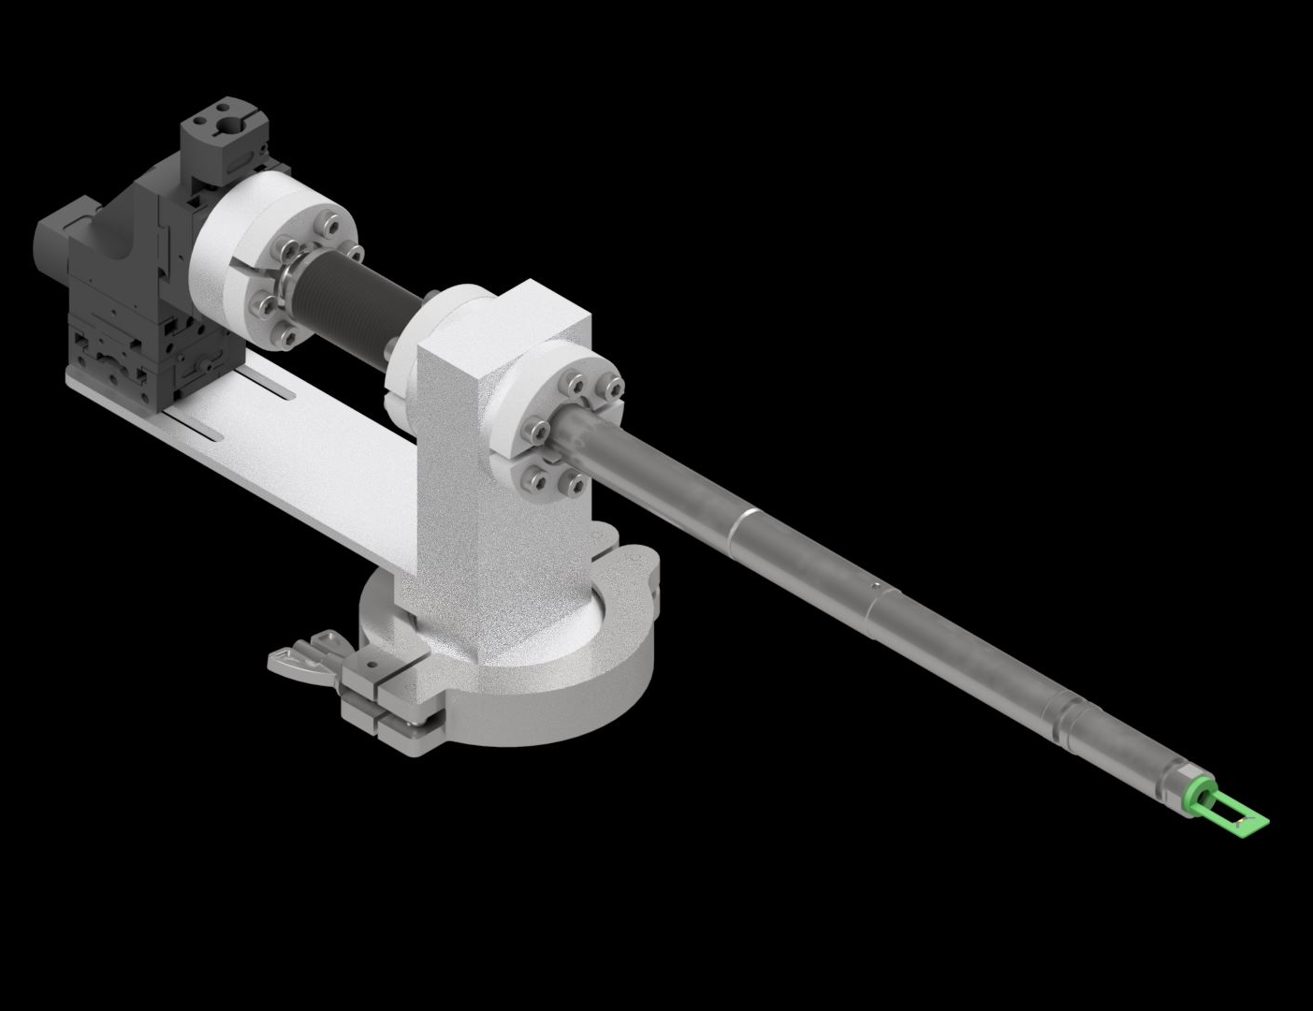
Scanning Transmission Electron Microscopy
Laser in situ project and recent collaborations

